Slide 1
CAPSTONE PROJECT
Application Infrastructure on Cloud
CLOUD COMPUTING AND SYSOPS
PREPARED BY:
V.RAMACHANDIRAN

Slide 2
INTRODUCTION:
Whiteboard Jr. is a software organization that provides application solutions for several organizations. Due to issues in managing the large infrastructure and rising costs, the company has decided to move its infrastructure to the cloud.

Slide 3
Current Problems with the IT Infrastructure :
Continuity of the application: When datacenter resources such as servers go down, the company is not able to manage and bring up the applications and run them quickly.
Service delivery location: Most employees complain about connectivity issues with the company servers while working from remote locations.
Cost of the resources: Most of the time, the IT resources are either over utilized, which leads to downtime, or underutilized making the resource purchase not very useful.

Slide 4
REQUIREMENTS
Reliability/Redundancy
Fail-Over and backups
Scalability
Security
Cost Management

Slide 5
TASKS
DESIGN
SETUP VPC
AUTOMATION USING ANSIBLE
APPLICATION AND INSTANCE FLEET
IAM SOLUTIONS
MONITORING SOLUTIONS

Slide 6
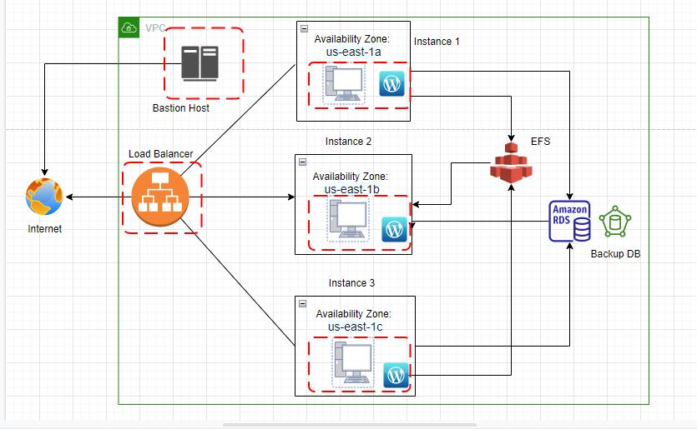
DESIGN

Slide 7
VPC
Amazon VPC enables you to build a virtual network in the AWS cloud.
All the resources need to be isolated and secured with network security.
In Amazon VPC You can specify an IP address range for the VPC, add subnets, add routes, add gateways, and associate security groups.

Slide 8
OBJECTIVES:
VPC CREATION
6 SUBNETS
INTERNET GATEWAY
NAT GATEWAY
CONFIGURATION OF ROUTE TABLE
SECURITY GROUP

Slide 9
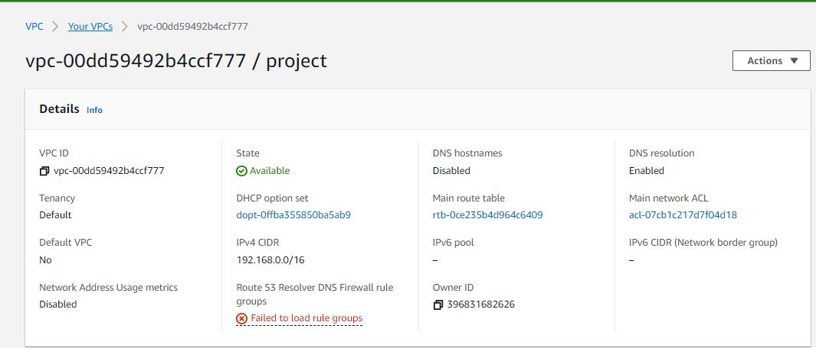
VPC SETUP

Slide 10
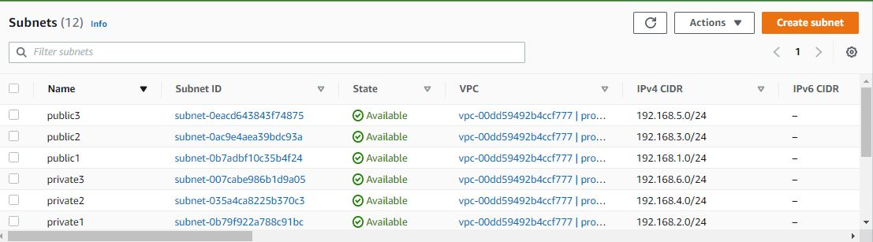
SUBNETS

Slide 11
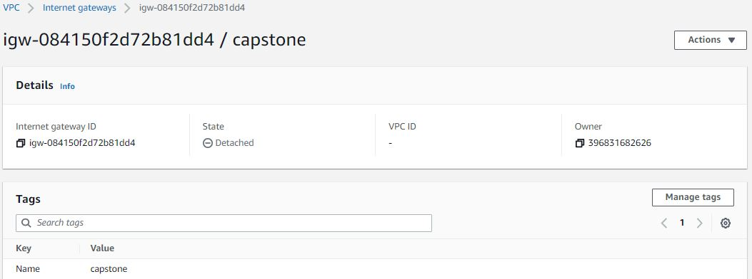
Internet Gateway

Slide 12
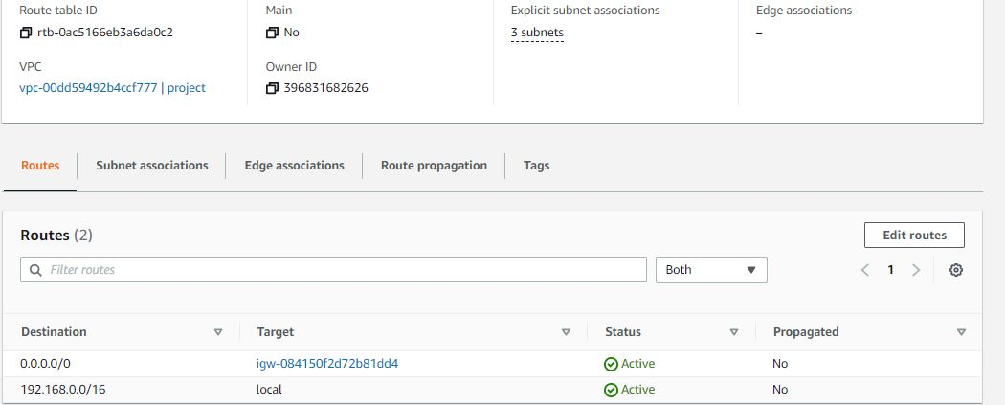
Route Table ( Public subnet) :

Slide 13
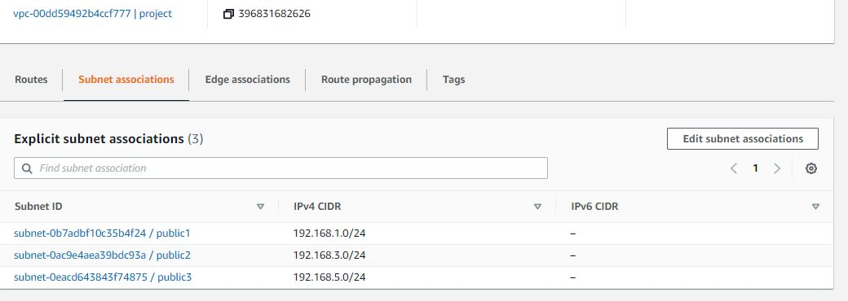
Subnet Associations

Slide 14
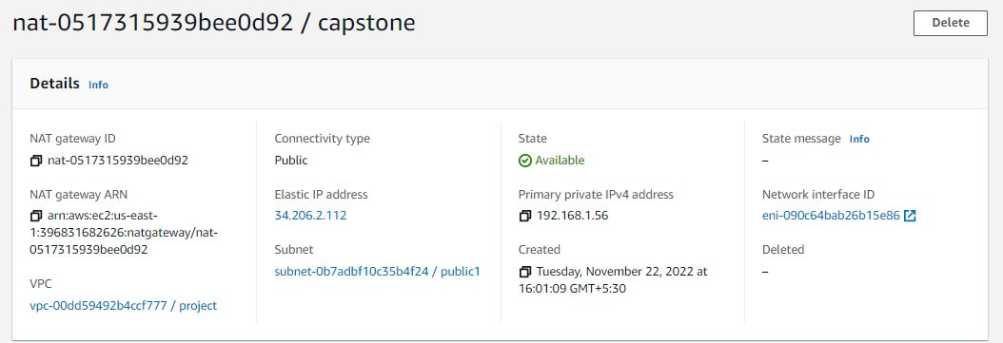
NAT Gateway

Slide 15
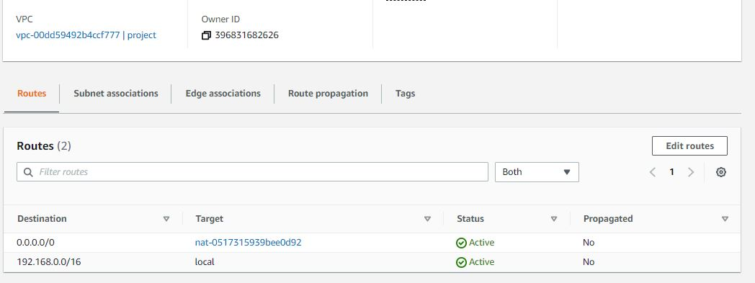
Route Table

Slide 16
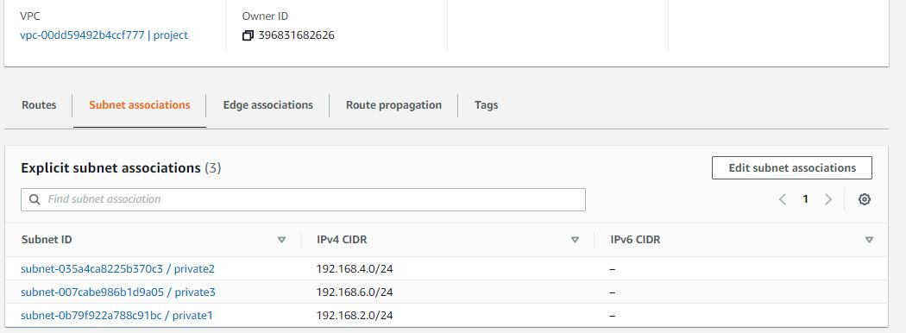
Subnet Associations

Slide 17
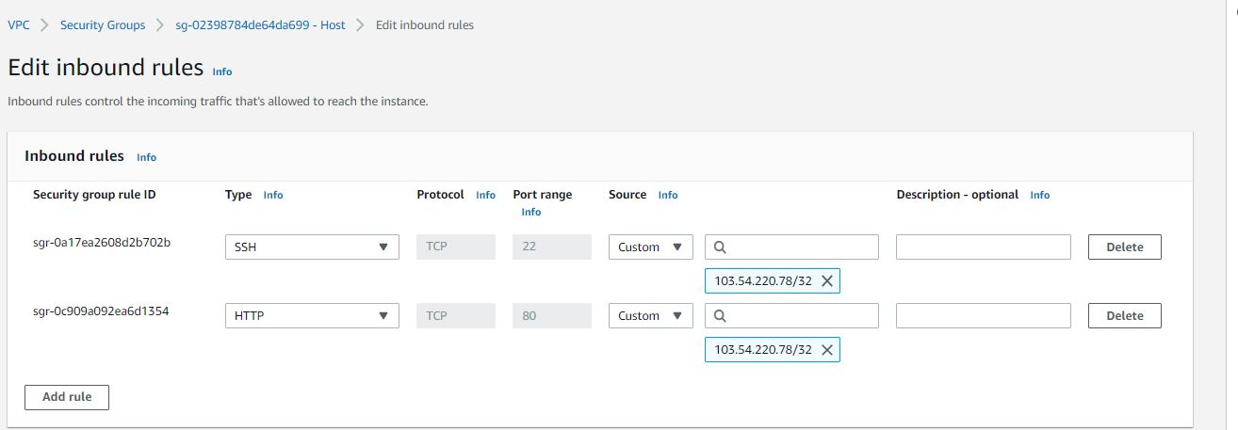
SECURITY GROUP(HOST)

Slide 18
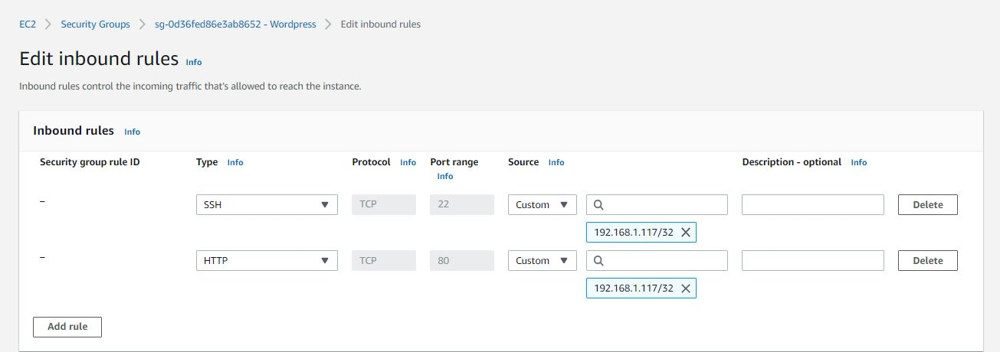
SECURITY GROUP(INSTANCE):

Slide 19
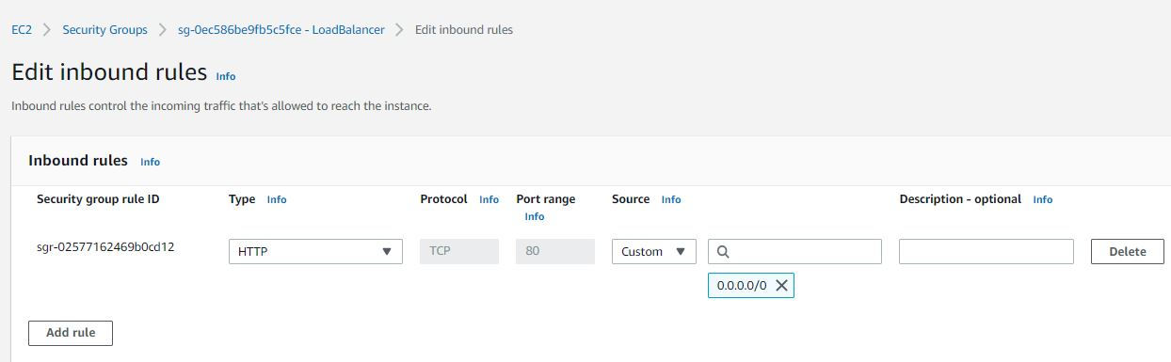
SECURITY GROUP(Load Balancer)

Slide 20
Implement Automation Using Ansible

Slide 21
Ansible
Ansible is great choice for basic automation of system administration tasks.
Ansible is most powerful feature of creating playbooks, a small piece of YAML code.
As per the requirement we used two playbooks and one MOTD Jinja 2 templates.

Slide 22
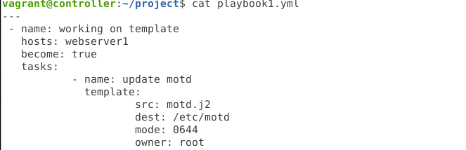
PLAYBOOK1

Slide 23
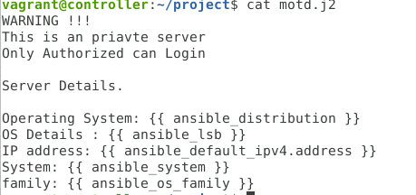
MOTD.J2 TEMPLATE FOR SSH LOGIN

Slide 24
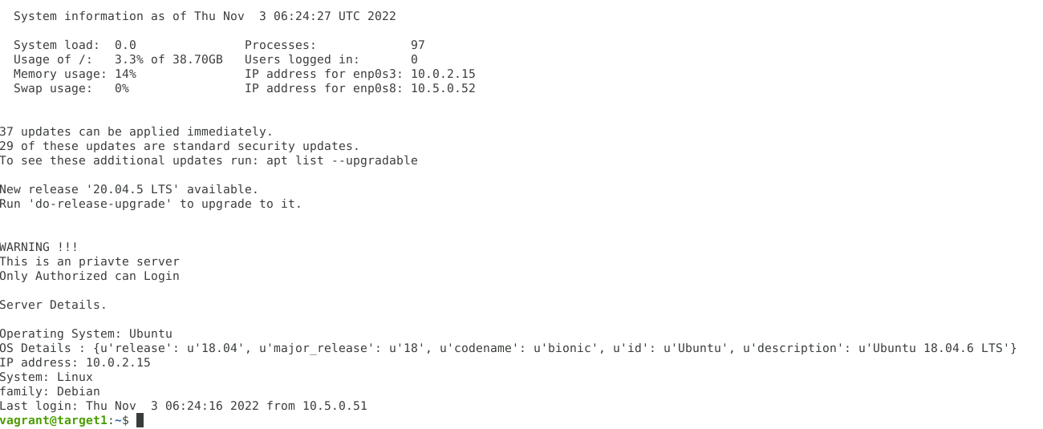
WELCOME MESSAGE DURING SSH LOGIN

Slide 25
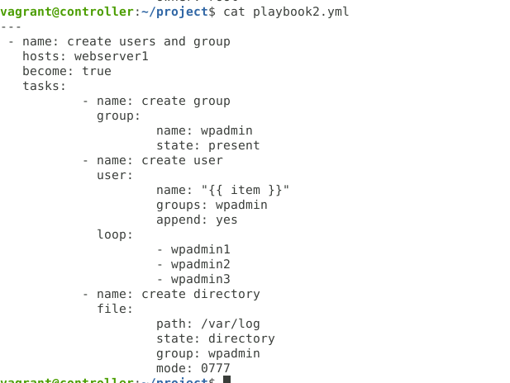
PLAYBOOK2

Slide 26
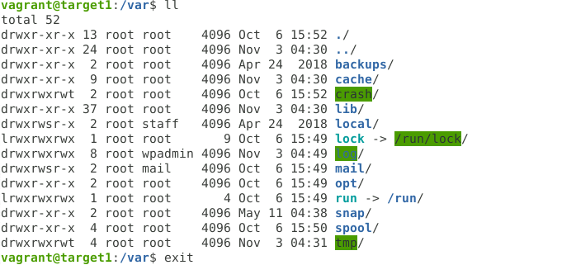
PERMISSIONS

Slide 27
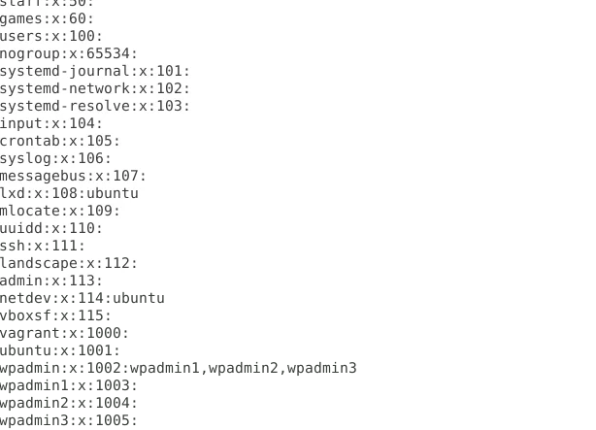
GROUP AND USERS

Slide 28
Implementing Application and Instances Fleet

Slide 29
CONFIGURATIONS
Configure Amazon Relational Database Service (Amazon RDS)
Install Wordpress
Configure Load Balancer
Configure Amazon Elastic File System (EFS)
Create a snapshot
Create Auto Scaling

Slide 30
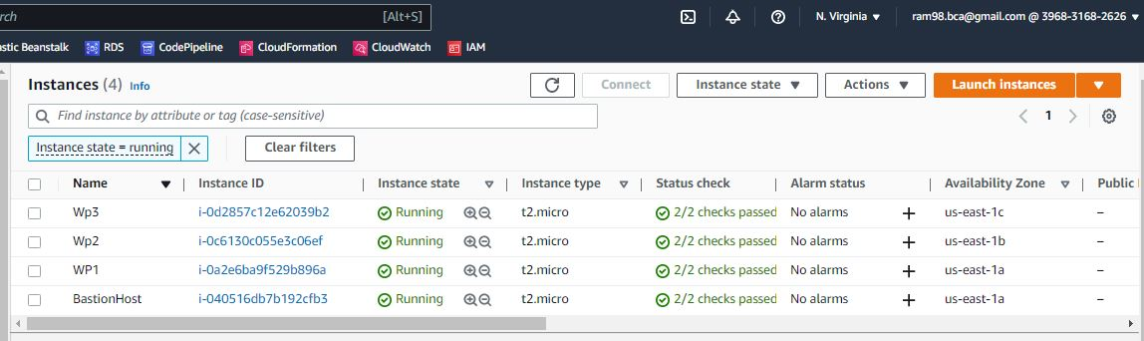
CREATE INSTANCE

Slide 31
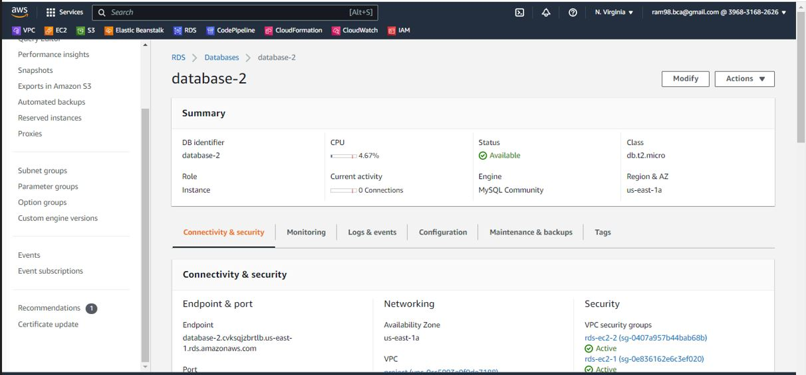
ATTACHING AWS RDS

Slide 32
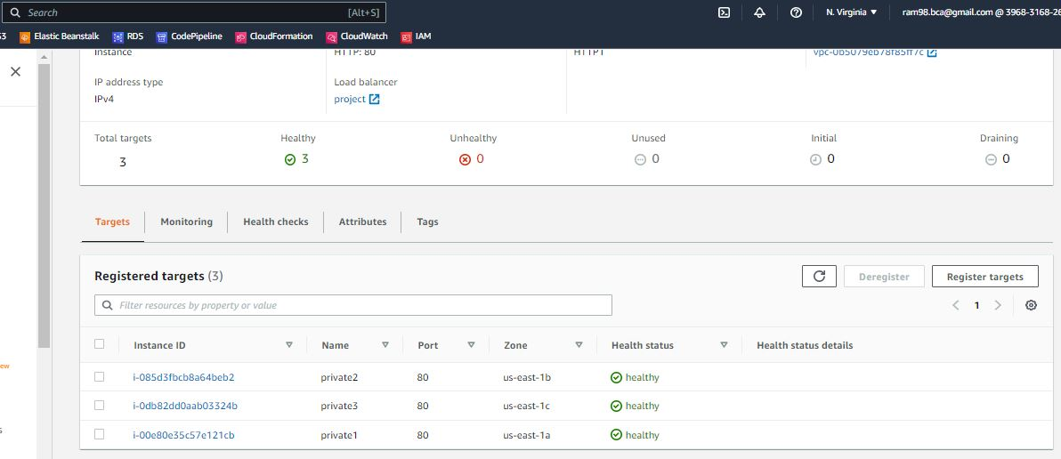
LOAD BALANCER

Slide 33
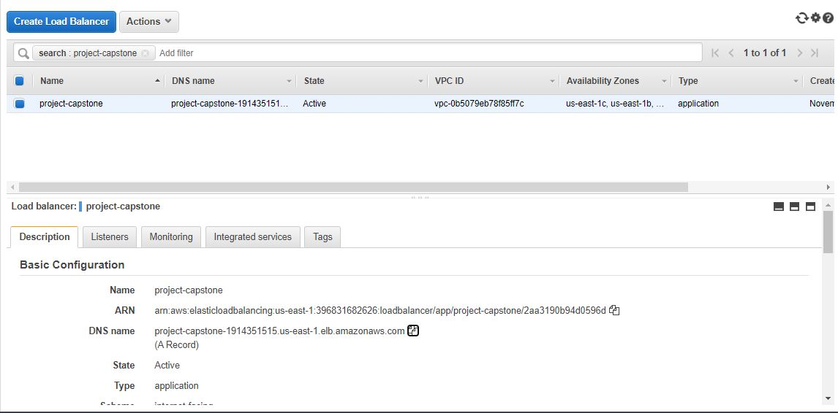
Target Group

Slide 34
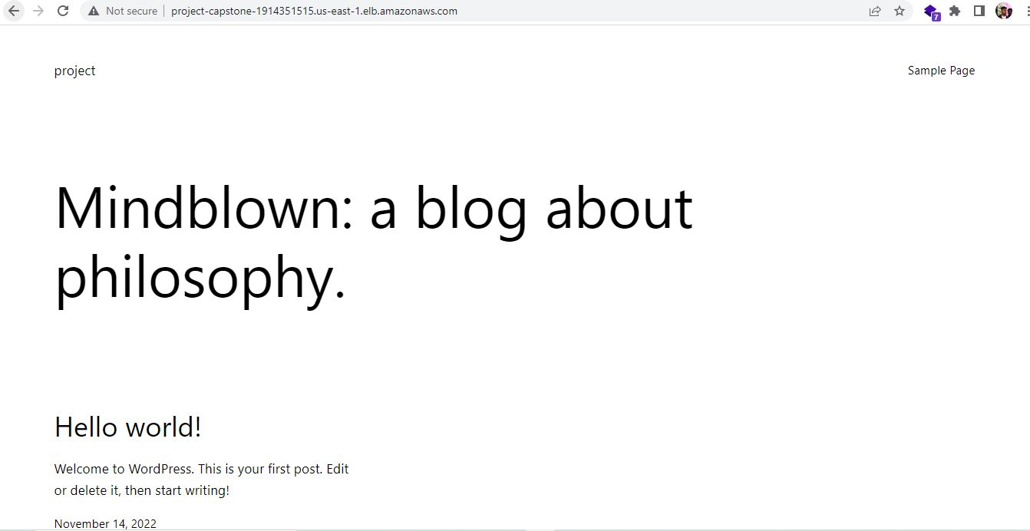
WORDPRESS

Slide 35
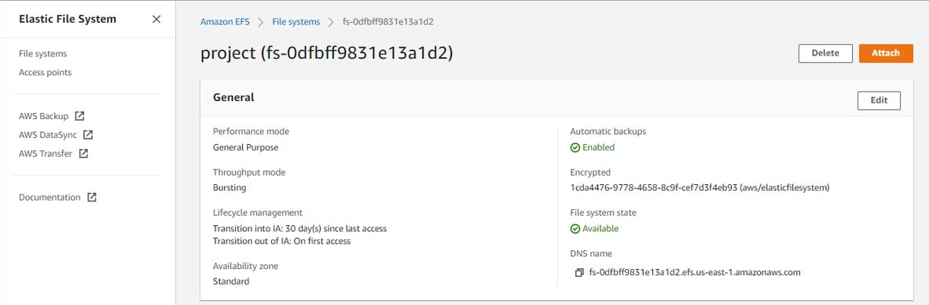
ATTACH EFS

Slide 36
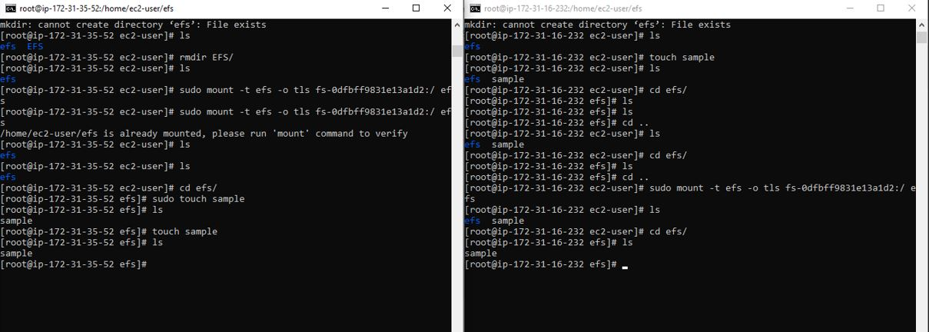
EFS INSTALLED

Slide 37
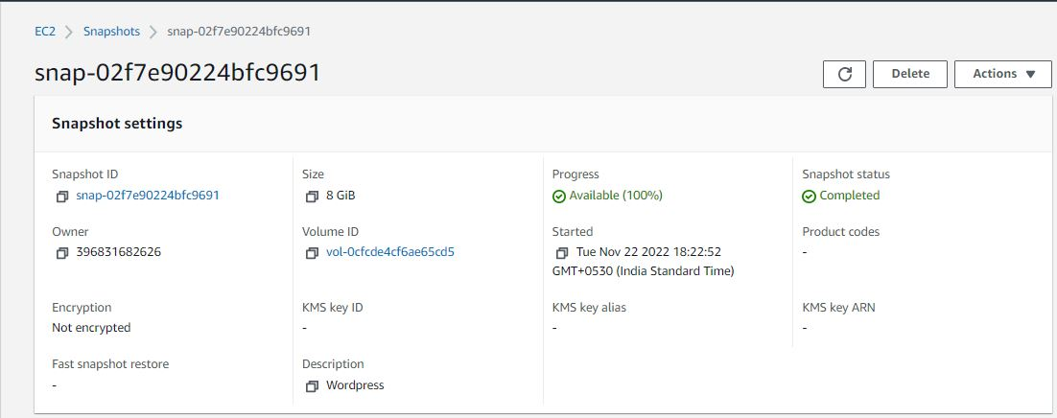
IMAGE OF INSTANCE

Slide 38
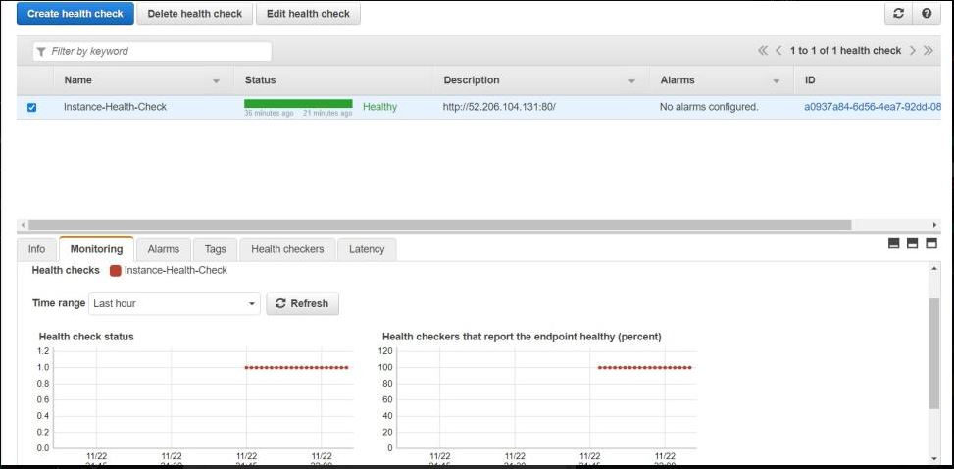
Route 53

Slide 39
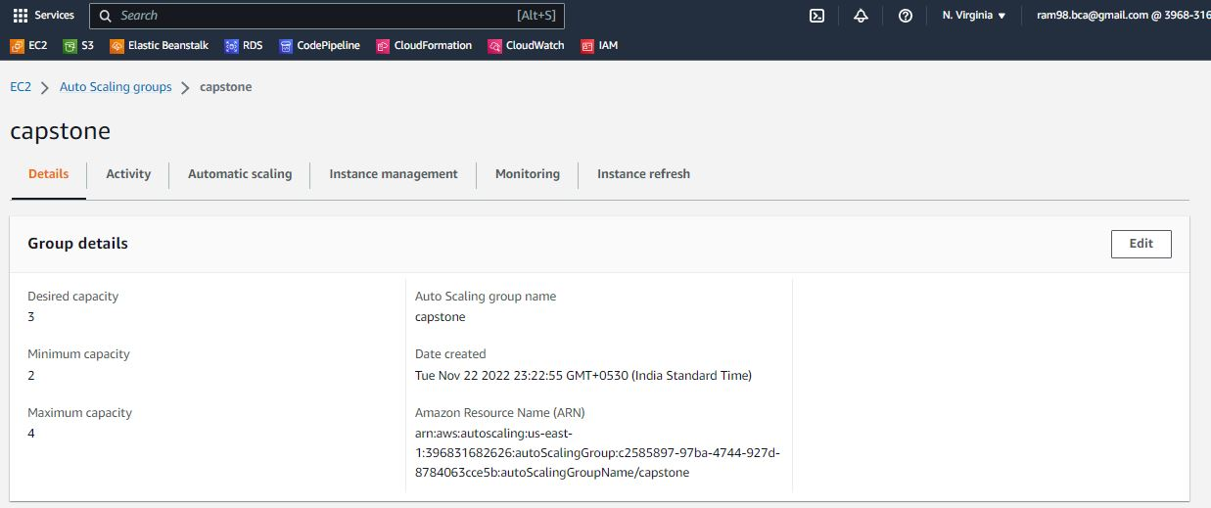
Auto Scaling:

Slide 40
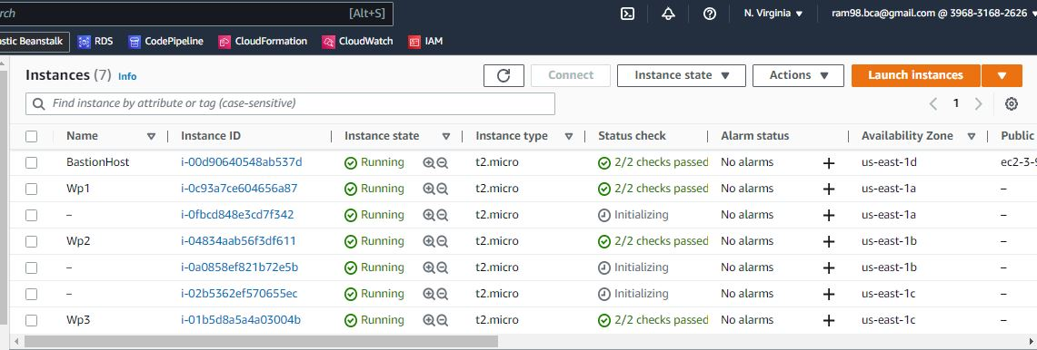
Result of Auto Scaling:

Slide 41
IMPLEMENTING IAM SOLUTIONS
Implement IAM Solution

Slide 42
IAM
Users, groups, and privileges are an essential part of every infrastructure.
Identity management, also known as identity and access management(IAM), is a framework of policies and technologies to ensure that the right users have the appropriate access to technology resources.
Company employees must be granted permission to work on cloud resources.

Slide 43
IAM GROUPS AND ROLES
Group Name
Role
Code pipeline full access, Administrator Access.
RDS full Access
CloudWatch full Access
VPC full Access
EC2 full Access
Software Admin
Database Admin
Log Admin
Network Admin
EC2 Admin

Slide 44
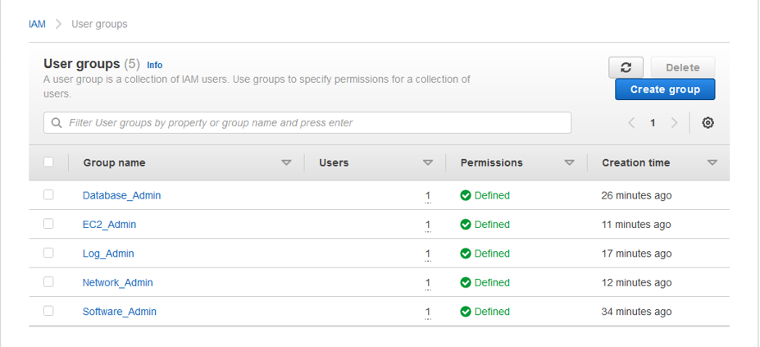
IAM GROUP AND USERS

Slide 45
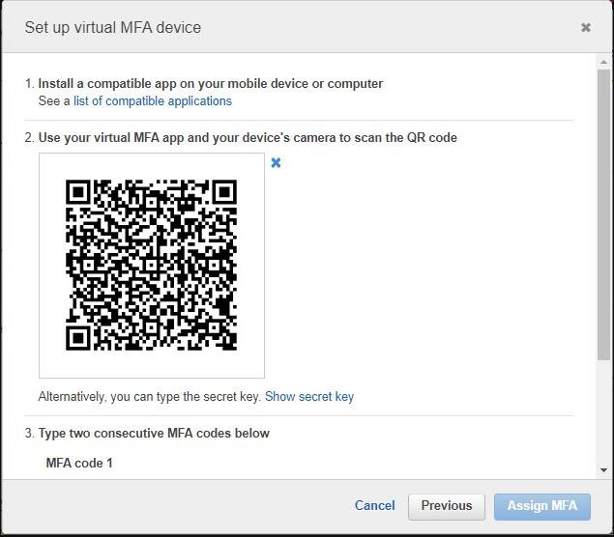
MFA

Slide 46
Implement Monitoring Solutions

Slide 47
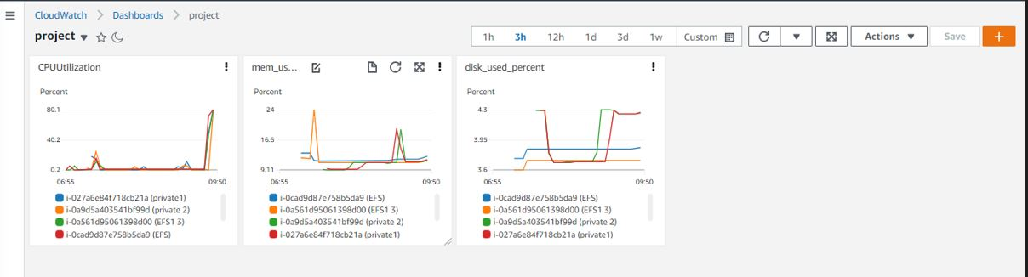
CLOUD WATCH

Slide 48
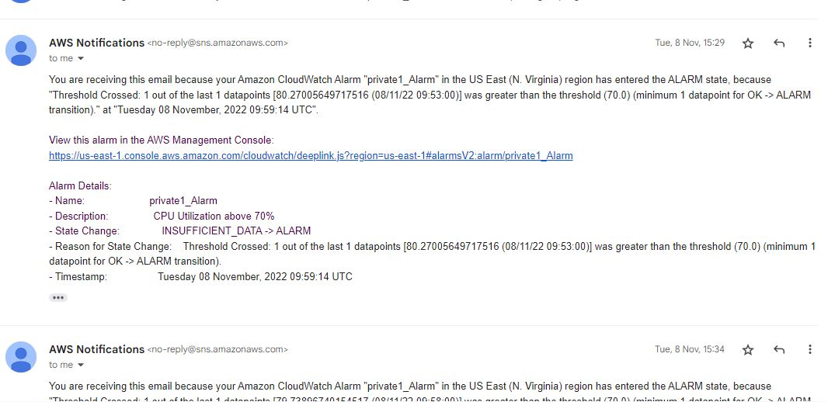
CPU UTILIZATION - ALARM

Slide 49
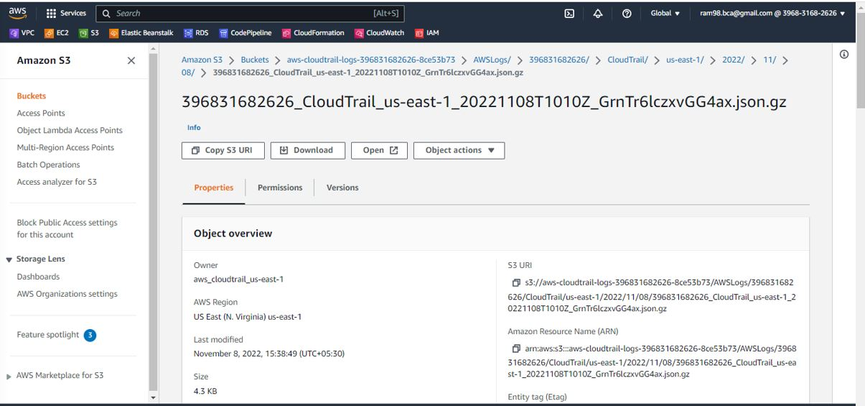
CLOUDTRAIL

Slide 50
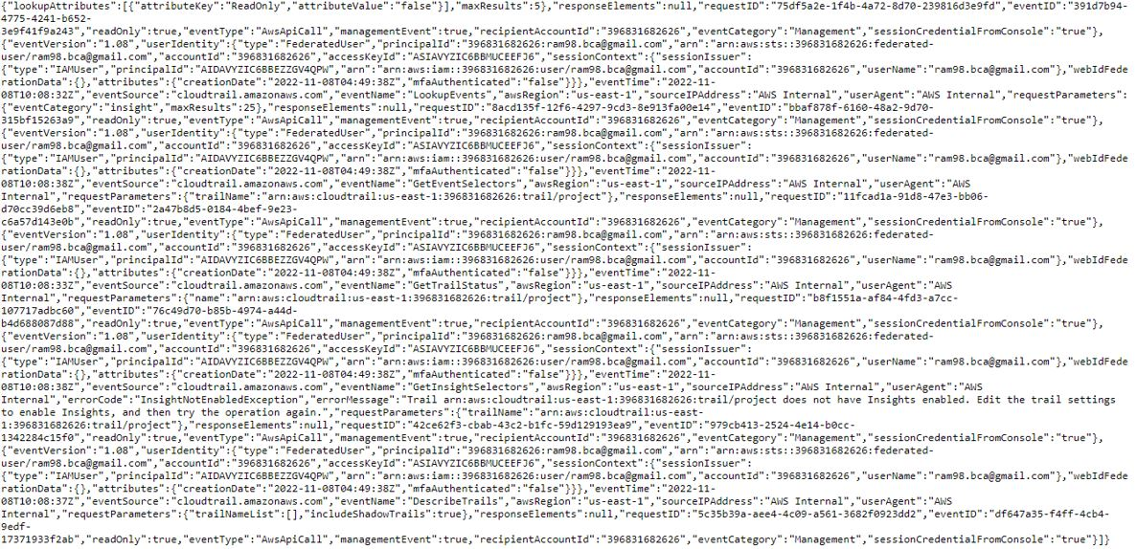
SYSTEM LOGS

Slide 51
CHALLENGE FACED:
Creating the raw Design of the project is first challenge I’ve faced.
Installing WordPress took more time than other Sprints.
Creating Ansible Playbook regarding client requirement was quiet difficult.

Slide 52
THANK YOU

